Slide 1
PIEZO ELECTRIC BASED CANTILEVER SYSTEM
SHREYAS R PILLAI
AM.EN.U4ECE20148
YADUKRISHNAN CP
AM.EN.U4ECE20055

Slide 2
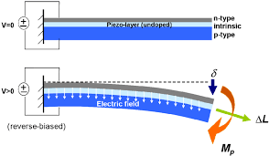
Introduction
Piezoelectricity is the ability of certain materials to generate an electric charge in response to applied mechanical stress. This phenomenon has been utilized in various applications, including sensors, actuators, and energy harvesters.
One particular application of piezoelectricity is in cantilever systems, where a piezoelectric material is attached to a cantilever beam. When the beam is deflected by an external force, the piezoelectric material generates an electric charge that can be measured.

Slide 3

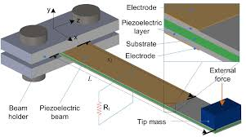
Design and Fabrication
The design of a piezoelectric-based cantilever system involves selecting a suitable piezoelectric material and designing the cantilever beam to ensure optimal performance. The fabrication process typically involves depositing the piezoelectric material onto the cantilever beam using techniques such as sputtering or chemical vapor deposition.
The dimensions of the cantilever beam and the thickness of the piezoelectric layer are critical parameters that affect the sensitivity and frequency response of the system. Careful optimization of these parameters is necessary to achieve the desired performance.

Slide 4
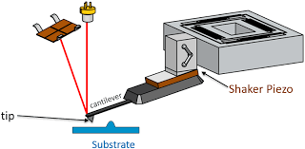
Applications
Piezoelectric-based cantilever systems have found numerous applications in sensing and actuation. One common application is in atomic force microscopy (AFM), where the deflection of the cantilever is used to measure surface topography at the nanoscale.
Other applications include biosensors, where the cantilever is functionalized with specific biomolecules to detect target analytes, and energy harvesting, where the deflection of the cantilever is used to generate electricity from ambient vibrations.

Slide 5
Advantages and Limitations
One major advantage of piezoelectric-based cantilever systems is their high sensitivity and fast response time.
They are also relatively easy to fabricate and can be integrated with other microelectronic components.
However, these systems are limited by their low power output and susceptibility to noise and drift.
Careful calibration and signal processing techniques are necessary to overcome these limitations and achieve accurate measurements.

Slide 6
Conclusion
Piezoelectric-based cantilever systems offer a powerful tool for sensing and actuation at the micro- and nanoscale. Their high sensitivity and fast response time make them ideal for a wide range of applications, from atomic force microscopy to biosensing and energy harvesting.
As research in this field continues, we can expect to see further improvements in performance and new applications emerging, making piezoelectric-based cantilever systems an exciting area of research and development.

